Slide 1
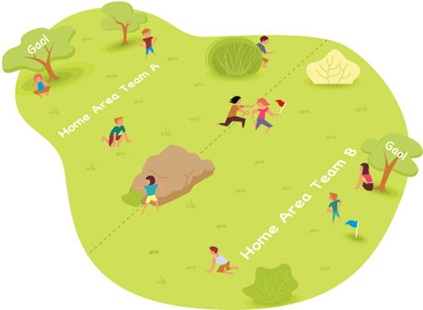
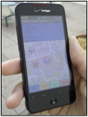
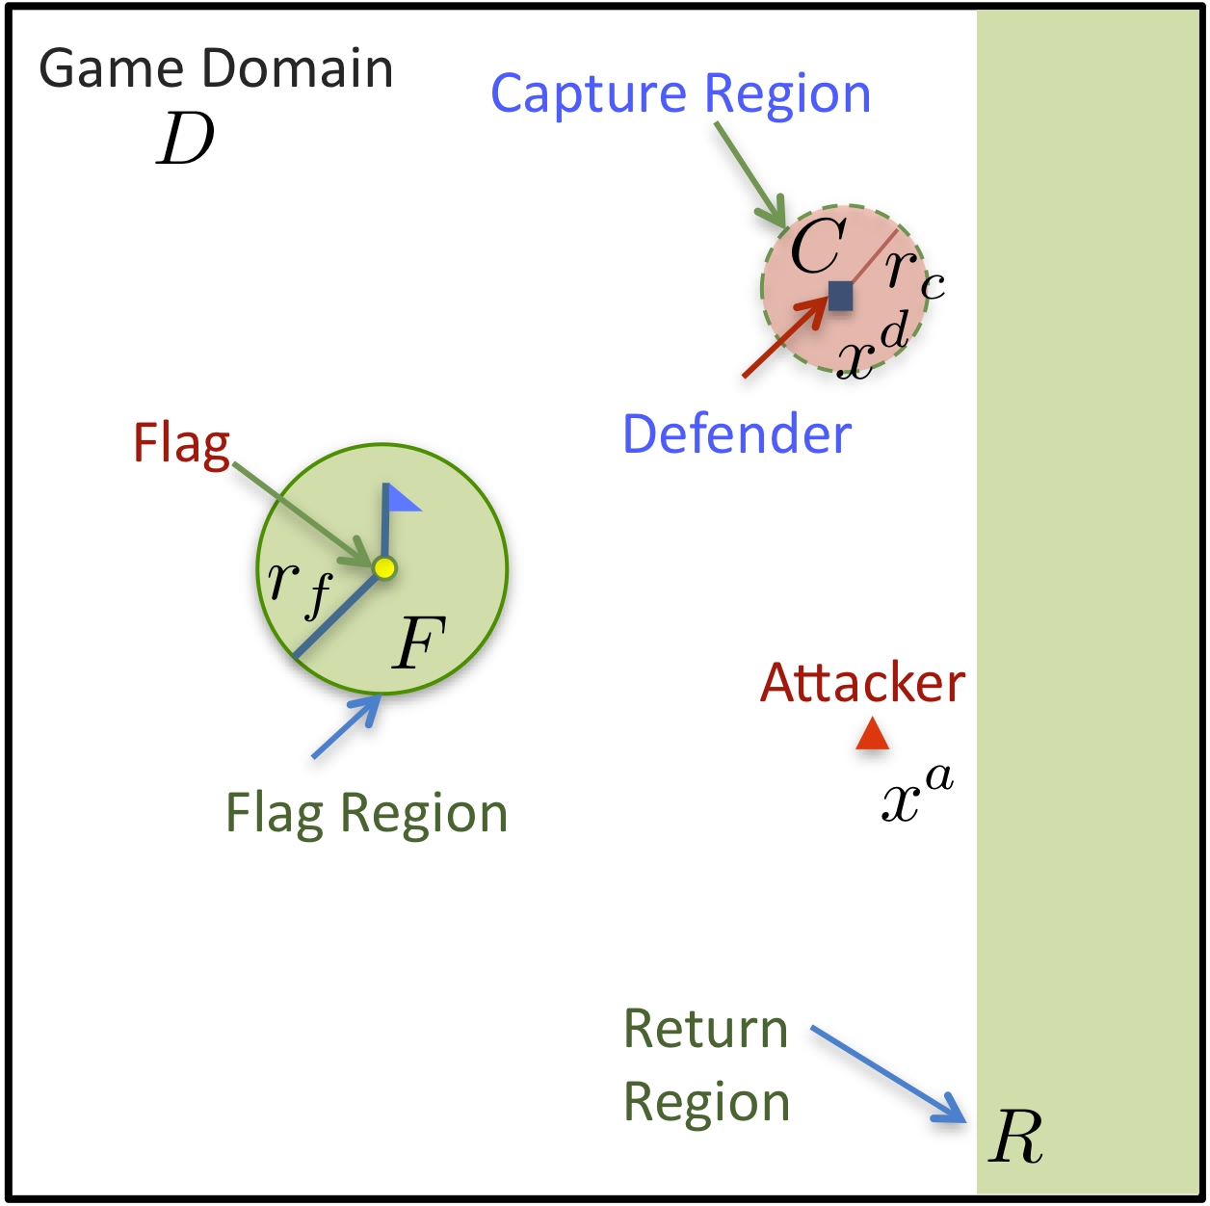
A Differential Game Approach to Planning in Adversarial Scenarios: A Case Study on Capture-the-Flag
Haomiao Huang, Jerry Ding, Wei Zhang, and Claire J. Tomlin
Aeronautics and Astronautics, Stanford, USA
Electrical Engineering and Computer Sciences , UC Berkeley, USA
Capture-the-flag is a useful platform for automation research in complex, adversarial scenarios.
The fully observable 1-on-1 game is analyzed using Hamilton-Jacobi reachability, with no assumptions on player strategies other than limited planar velocity.
Winning regions and policies are computed for each player.
Regions are used to guide human players aided by GPS-equipped smart-phones.
Capture-the-flag scenario and smart-phone application for automation-aided game.

